Slide 1
http://www.vidyanidhi.com/
ketkiacharya.net@gmail.com
Ketki Acharya
From: SM VITA ATC of CDAC
ketkiacharya.net@gmail.com

Slide 2
MVC
ASP.NET MVC 5 is a web framework based on
Mode-View-Controller (MVC) architecture.
Developers can build dynamic web applications using ASP.NET MVC framework that enables a
clean separation of concerns,
fast development, and
TDD friendly.

Slide 3
Model: Model represents the shape of the data. A class in C# is used to describe a model. Model objects store data retrieved from the database.
Model represents the data.
View: View in MVC is a user interface. View display model data to the user and also enables them to modify them. View in ASP.NET MVC is HTML, CSS, and some special syntax (Razor syntax) that makes it easy to communicate with the model and the controller.
View is the User Interface.
Controller: The controller handles the user request. Typically, the user uses the view and raises an HTTP request, which will be handled by the controller. The controller processes the request and returns the appropriate view as a response.
Controller is the request handler.

Slide 4
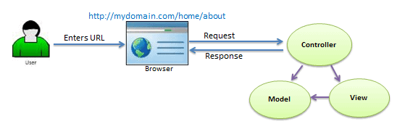
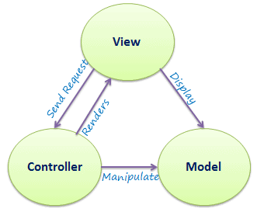
As per the above figure, when a user enters a URL in the browser, it goes to the webserver and routed to a controller.
A controller executes related view and models for that request and create the response and sends it back to the browser.

Slide 5
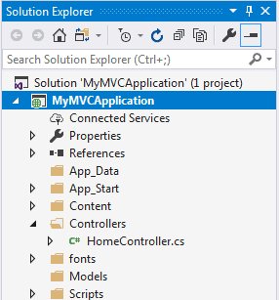
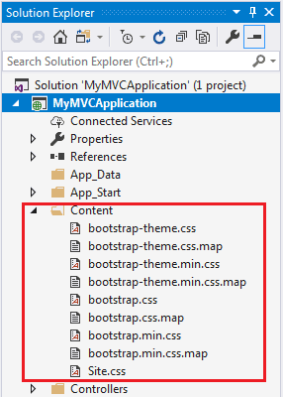
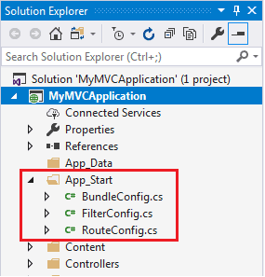
ASP.NET MVC Folder Structure
App_Data
The App_Data folder can contain application data files like LocalDB, .mdf files, XML files, and other data related files. IIS will never serve files from App_Data folder.
App_Start
The App_Start folder can contain class files that will be executed when the application starts. Typically, these would be config files like AuthConfig.cs, BundleConfig.cs, FilterConfig.cs, RouteConfig.cs etc. MVC 5 includes BundleConfig.cs, FilterConfig.cs and RouteConfig.cs by default. We will see the significance of these files later.
Content
The Content folder contains static files like CSS files, images, and icons files. MVC 5 application includes bootstrap.css, bootstrap.min.css, and Site.css by default.
Controllers
The Controllers folder contains class files for the controllers. A Controller handles users' request and returns a response. MVC requires the name of all controller files to end with "Controller".

Slide 6
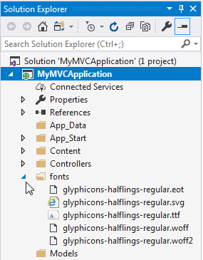
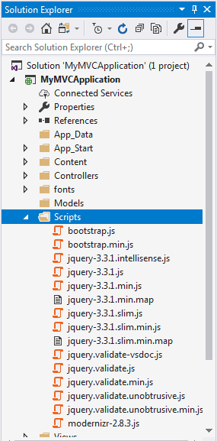
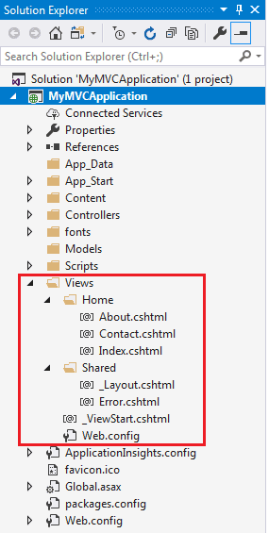
ASP.NET MVC Folder Structure
Views
The Views folder contains HTML files for the application. Typically view file is a .cshtml file where you write HTML and C# or VB.NET code.
The Views folder includes a separate folder for each controller. For example, all the .cshtml files, which will be rendered by HomeController will be in View > Home folder.
The Shared folder under the View folder contains all the views shared among different controllers e.g., layout files.
Models
The Models folder contains model class files. Typically model class includes public properties, which will be used by the application to hold and manipulate application data.
Scripts
The Scripts folder contains JavaScript or VBScript files for the application. MVC 5 includes javascript files for bootstrap, jquery 1.10, and modernizer by default.
fonts
The Fonts folder contains custom font files for your application.

Slide 7
Global.asax
Global.asax file allows you to write code that runs in response to application-level events, such as Application_BeginRequest, application_start, application_error, session_start, session_end, etc.
Packages.config
Packages.config file is managed by NuGet to track what packages and versions you have installed in the application.
Web.config
Web.config file contains application-level configurations.

Slide 8
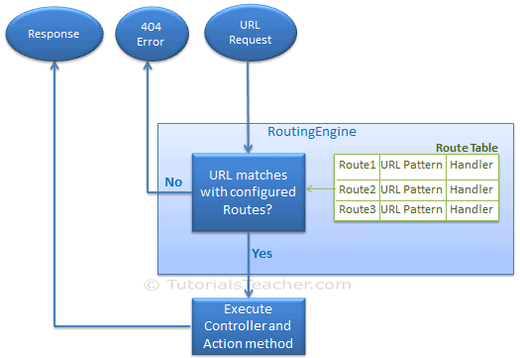
Routing in MVC
In the php application, every URL must match with a specific .php file. For example, a URL http://domain/studentsinfo.php must match with the file studentsinfo.php that contains code and markup for rendering a response to the browser.
Route defines the URL pattern and handler information. All the configured routes of an application stored in RouteTable and will be used by the Routing engine to determine appropriate handler class or file for an incoming request

Slide 9
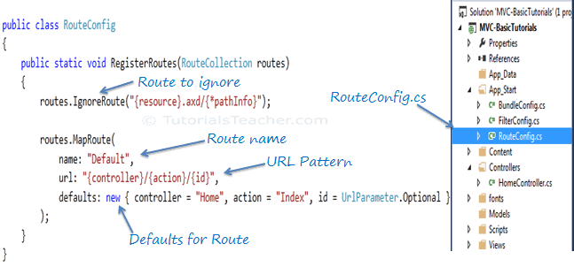
Configure a Route
Every MVC application must configure (register) at least one route configured by the MVC framework by default. You can register a route in RouteConfig class, which is in RouteConfig.cs under App_Start folder. The following figure illustrates how to configure a route in the RouteConfig class
As you can see in the above figure, the route is configured using the MapRoute() extension method of RouteCollection, where name is "Default", url pattern is "{controller}/{action}/{id}" and defaults parameter for controller, action method and id parameter.
Defaults specify which controller, action method, or value of id parameter should be used if they do not exist in the incoming request URL.
In the same way, you can configure other routes using the MapRoute() method of the RouteCollection class. This RouteCollection is actually a property of the RouteTable class.

Slide 10
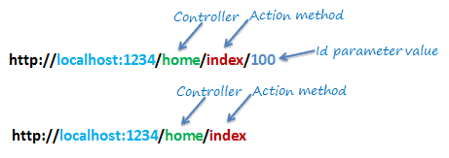
URL Pattern
The URL pattern is considered only after the domain name part in the URL. For example, the URL pattern "{controller}/{action}/{id}" would look like localhost:1234/{controller}/{action}/{id}. Anything after "localhost:1234/" would be considered as a controller name. The same way, anything after the controller name would be considered as action name and then the value of id parameter.
If the URL doesn't contain anything after the domain name, then the default controller and action method will handle the request. For example, http://localhost:1234 would be handled by the HomeController and the Index() method as configured in the default parameter.

Slide 11
The following table shows which Controller, Action method, and Id parameter would handle different URLs considering the above default route.
URL | Controller | Action | Id
http://localhost/home | HomeController | Index | null
http://localhost/home/index/123 | HomeController | Index | 123
http://localhost/home/about | HomeController | About | null
http://localhost/home/contact | HomeController | Contact | null
http://localhost/student | StudentController | Index | null
http://localhost/student/edit/123 | StudentController | Edit | 123

Slide 12
Multiple Routes
You can also configure a custom route using the MapRoute extension method. You need to provide at least two parameters in MapRoute, route name, and URL pattern. The Defaults parameter is optional.
You can register multiple custom routes with different names. Consider the following example where we register "Student" route.
As shown in the above code, the URL pattern for the Student route is students/{id}, which specifies that any URL that starts with domainName/students, must be handled by the StudentController.
Notice that we haven't specified {action} in the URL pattern because we want every URL that starts with students should always use the Index() action of the StudentController class. We have specified the default controller and action to handle any URL request, which starts from domainname/students.
MVC framework evaluates each route in sequence.
It starts with the first configured route, and if incoming URL doesn't satisfy the URL pattern of the route, then it will evaluate the second route and so on. In the above example, routing engine will evaluate the Student route first and if incoming URL doesn't start with /students then only it will consider the second route which is the default route.
public class RouteConfig {
public static void RegisterRoutes(RouteCollection routes)
{
routes.IgnoreRoute("{resource}.axd/{*pathInfo}");
routes.MapRoute( name: "Student",
url: "students/{id}",
defaults: new { controller = "Student", action = "Index"}
);
routes.MapRoute( name: "Default",
url: "{controller}/{action}/{id}",
defaults: new { controller = "Home", action = "Index", id = UrlParameter.Optional }
);
}
URL | Controller | Action | Id
http://localhost/student/123 | StudentController | Index | 123
http://localhost/student/index/123 | StudentController | Index | 123
http://localhost/student?Id=123 | StudentController | Index | 123

Slide 13
Route Constraints
You can also apply restrictions on the value of the parameter by configuring route constraints. For example, the following route applies a limitation on the id parameter that the id's value must be numeric.
routes.MapRoute( name: "Student", url: "student/{id}/{name}/{standardId}",
defaults: new { controller = "Student", action = "Index", id = UrlParameter.Optional, name = UrlParameter.Optional,
standardId = UrlParameter.Optional
},
constraints: new { id = @"\d+" }
);
So if you give non-numeric value for id parameter, then that request will be handled by another route or, if there are no matching routes, then "The resource could not be found" error will be thrown.

Slide 14
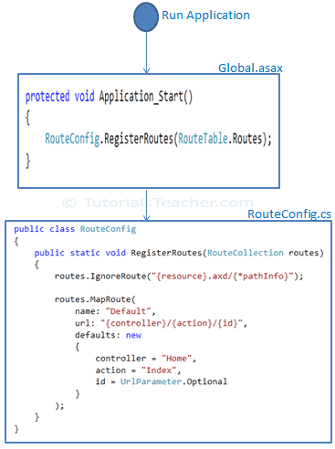
Register Routes
Now, after configuring all the routes in the RouteConfig class, you need to register it in the Application_Start() event in the Global.asax so that it includes all your routes into the RouteTable.
public class MvcApplication : System.Web.HttpApplication
{
Protected void Application_Start() {
RouteConfig.RegisterRoutes(RouteTable.Routes);
}
}

Slide 15
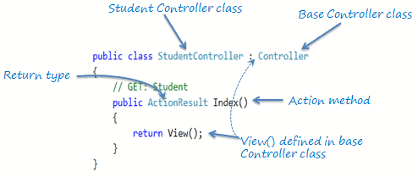
Controller/ Action method
The Controller in MVC architecture handles any incoming URL request. The Controller is a class, derived from the base class System.Web.Mvc.Controller. Controller class contains public methods called Action methods. Controller and its action method handles incoming browser requests, retrieves necessary model data and returns appropriate responses.
In ASP.NET MVC, every controller class name must end with a word "Controller". For example, the home page controller name must be HomeController, and for the student page, it must be the StudentController. Also, every controller class must be located in the Controller folder of the MVC folder structure.
All the public methods of the Controller class are called Action methods.
As you can see in the above figure, the Index() method is public, and it returns the ActionResult using the View() method. The View() method is defined in the Controller base class, which returns the appropriate ActionResult.

Slide 16
Default Action Method
Every controller can have a default action method as per the configured route in the RouteConfig class. By default, the Index() method is a default action method for any controller, as per configured default root, as shown below.
routes.MapRoute( name: "Default",
url: "{controller}/{action}/{id}/{name}",
defaults: new { controller = "Home", action = "Index", id = UrlParameter.Optional });
However, you can change the default action name as per your requirement in the RouteConfig class.

Slide 17
ActionResult
MVC framework includes various Result classes, which can be returned from an action method. The result classes represent different types of responses, such as HTML, file, string, JSON, javascript, etc. The following table lists all the result classes available in ASP.NET MVC.
The ActionResult class is a base class of all the above result classes, so it can be the return type of action method that returns any result listed above. However, you can specify the appropriate result class as a return type of action method.
Result Class | Description
ViewResult | Represents HTML and markup.
EmptyResult | Represents No response.
ContentResult | Represents string literal.
FileContentResult/ FilePathResult/ FileStreamResult | Represents the content of a file.
JavaScriptResult | Represent a JavaScript script.
JsonResult | Represent JSON that can be used in AJAX.
RedirectResult | Represents a redirection to a new URL.
RedirectToRouteResult | Represent another action of same or other controller.
PartialViewResult | Returns HTML from Partial view.
HttpUnauthorizedResult | Returns HTTP 403 status.

Slide 18
ViewResult
The Index() method of the StudentController in the above figure uses the View() method to return a ViewResult (which is derived from the ActionResult class).
The base Controller class includes the View() method along with other methods that return a particular type of result, as shown in the below table.
Result Class | Description | Base Controller Method
ViewResult | Represents HTML and markup. | View()
EmptyResult | Represents No response.
ContentResult | Represents string literal. | Content()
FileContentResult, FilePathResult, FileStreamResult | Represents the content of a file. | File()
JavaScriptResult | Represents a JavaScript script. | JavaScript()
JsonResult | Represents JSON that can be used in AJAX. | Json()
RedirectResult | Represents a redirection to a new URL. | Redirect()
RedirectToRouteResult | Represents redirection to another route. | RedirectToRoute()
PartialViewResult | Represents the partial view result. | PartialView()
HttpUnauthorizedResult | Represents HTTP 403 response.

Slide 19
Action Method Parameters
[HttpPost]
public ActionResult Edit(Student std)
{ // update student to the database
return RedirectToAction("Index");
}
[HttpDelete]
public ActionResult Delete(int id)
{ // delete student from the database whose id matches with specified id
return RedirectToAction("Index");
}
By default, the values for action method parameters are retrieved from the request's data collection. The data collection includes name/values pairs for form data or query string values or cookie values. Model binding in ASP.NET MVC automatically maps the URL query string or form data collection to the action method parameters if both names match.

Slide 20
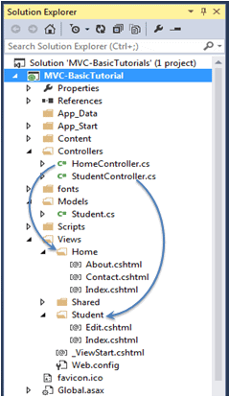
Create a View in ASP.NET MVC
A view is used to display data using the model class object. The Views folder contains all the view files in the ASP.NET MVC application.
A controller can have one or more action methods, and each action method can return a different view. In short, a controller can render one or more views. So, for easy maintenance, the MVC framework requires a separate sub-folder for each controller with the same name as a controller, under the Views folder.
For example, all the views rendered from the HomeController will resides in the Views > Home folder. In the same way, views for StudentController will resides in Views > Student folder, as shown below.
Note:
The Shared folder contains views, layout views, and partial views, which will be shared among multiple controllers
Note:
Every view in the ASP.NET MVC is derived from WebViewPage class included in System.Web.Mvc namespace.
Razor View Engine
Microsoft introduced the razor view engine to compile a view with a mix of HTML tags and server-side code. The special syntax for razor view maximizes the speed of writing code by minimizing the number of characters and keystrokes required when writing a view.
The razor view uses @ character to include the server-side code instead of the traditional <% %> of ASP. You can use C# or Visual Basic syntax to write server-side code inside the razor view.
ASP.NET MVC supports the following types of razor view files:
File extension | Description
.cshtml | C# Razor view. Supports C# code with html tags.
.vbhtml | Visual Basic Razor view. Supports Visual Basic code with html tags.
.aspx | ASP.Net web form
.ascx | ASP.NET web control

Slide 21
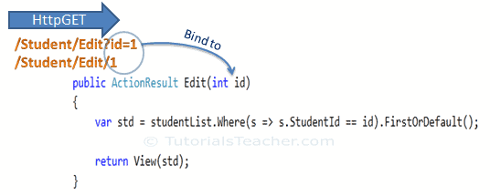
Bind Query String to an Action Method Parameters in MVC
Binding to Primitive Type
The HTTP GET request embeds data into a query string. MVC framework automatically converts a query string to the action method parameters provided their names are matching. For example, the query string id in the following GET request would automatically be mapped to the Edit() action method's id parameter.
Model Binding
This binding is case insensitive. So "id" parameter can be "ID" or "Id".
You can also have multiple parameters in the action method with different data types. Query string values will be converted into parameters based on the matching names.
For example, the query string parameters of an HTTP request http://localhost/Student/Edit?id=1&name=John would map to id and name parameters of the following Edit() action method.
For example, the query string parameters of an HTTP request http://localhost/Student/Edit?id=1&name=John would map to id and name parameters of the following Edit() action method.
public ActionResult Edit(int id, string name)
{
// do something here
return View();
}
This binding is case insensitive. So "id" parameter can be "ID" or "Id".

Slide 22
Binding to Complex Type
Model binding also works on complex types. It will automatically convert the input fields data on the view to the properties of a complex type parameter of an action method in HttpPost request if the properties' names match with the fields on the view.
[HttpPost]
public ActionResult Edit(Student std)
{
var id = std.StudentId;
var name = std.StudentName;
var age = std.Age;
var standardName = std.standard.StandardName;
//update database here..
return RedirectToAction("Index");
}
public class Student
{
public int StudentId { get; set; }
public string StudentName { get; set; }
public int Age { get; set; }
public Standard standard { get; set; }
}
public class Standard
{
public int StandardId { get; set; }
public string StandardName { get; set; }
}
Now, you can create an action method which includes the Student type parameter. In the following example, Edit action method (HttpPost) includes Student type parameter.

Slide 23
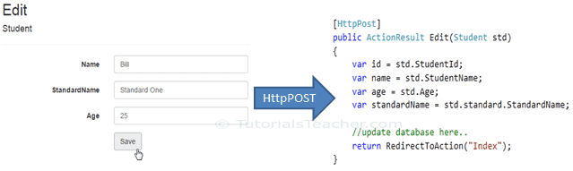
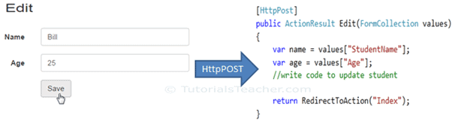
Thus, the MVC framework will automatically map Form collection values to the Student type parameter when the form submits an HTTP POST request to the Edit() action method, as shown below.
So thus, it automatically binds form fields to the complex type parameter of action method
FormCollection
You can also include the FormCollection type parameter in the action method instead of a complex type to retrieve all the values from view form fields, as shown below.

